Slide 1
CSE221
Structure and Interpretation of
Computer Programs
Substitution Model for Procedure Application

Slide 2
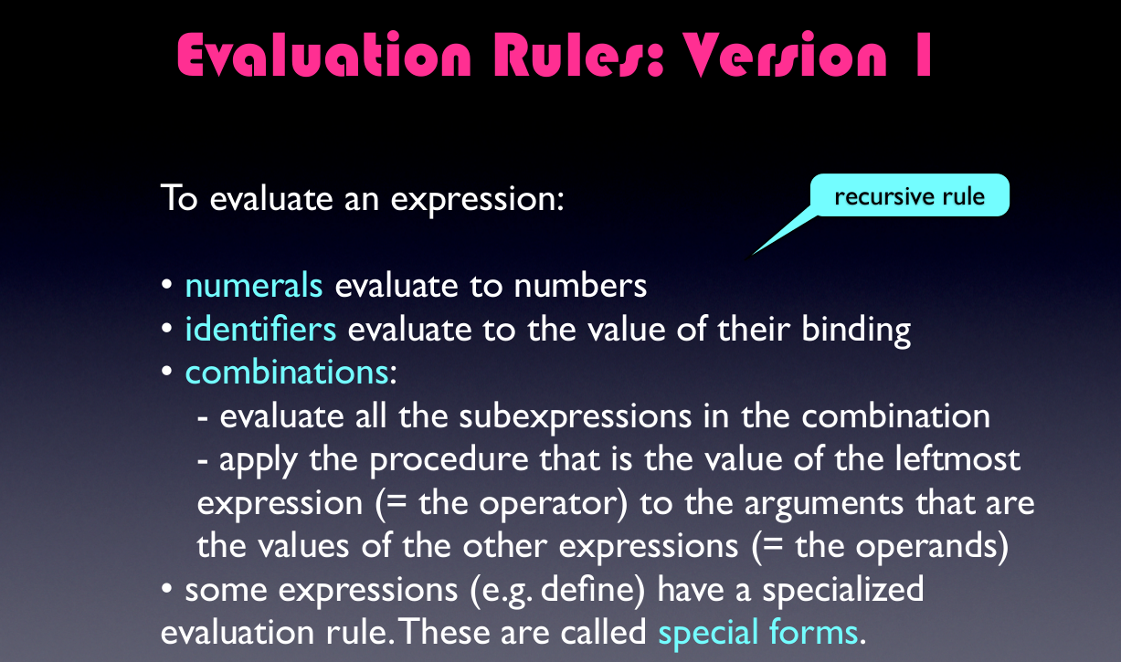

Slide 3
Substitution Model
(define (f a)
(sum-of-squares (+ a 1) (* a 2)))
(define (sum-of-squares x y)
(+ (square x) (square y)))

Slide 4
Applicative-order Evaluation
Procedure’s (function’s) arguments or sub-expressions are evaluated first.
Then the procedure definition is applied.
That is, First evaluate the arguments (operators and operands) and then apply procedure.
  Advantages:
Lesser Computations are required.
  Disadvantages :
    Recursive procedures.
    Conditional procedures

Slide 5
Applicative-order Evaluation
(f 5)

Slide 6
Applicative-order Evaluation
(f 5)
(sum-of-squares (+ a 1) (* a 2)))

Slide 7
Applicative-order Evaluation
(f 5)
(sum-of-squares (+ a 1) (* a 2)))
(sum-of-squares (+ 5 1) (* 5 2)))

Slide 8
Applicative-order Evaluation
(f 5)
(sum-of-squares (+ a 1) (* a 2)))
(sum-of-squares (+ 5 1) (* 5 2)))
(sum-of-squares 6 10)

Slide 9
Applicative-order Evaluation
(f 5)
(sum-of-squares (+ a 1) (* a 2)))
(sum-of-squares (+ 5 1) (* 5 2)))
(sum-of-squares 6 10)
(+ (square 6) (square 10))

Slide 10
Applicative-order Evaluation
(f 5)
(sum-of-squares (+ a 1) (* a 2)))
(sum-of-squares (+ 5 1) (* 5 2)))
(sum-of-squares 6 10)
(+ (square 6) (square 10))
(+ (* 6 6) (* 10 10))

Slide 11
Applicative-order Evaluation
(f 5)
(sum-of-squares (+ a 1) (* a 2)))
(sum-of-squares (+ 5 1) (* 5 2)))
(sum-of-squares 6 10)
(+ (square 6) (square 10))
(+ (* 6 6) (* 10 10))
(+ 36 100)

Slide 12
Applicative-order Evaluation
(f 5)
(sum-of-squares (+ a 1) (* a 2)))
(sum-of-squares (+ 5 1) (* 5 2)))
(sum-of-squares 6 10)
(+ (square 6) (square 10))
(+ (* 6 6) (* 10 10))
(+ 36 100)
136

Slide 13
Normal-order Evaluation
Fully expand and then reduce approach.
Always reduces the left-most outer-most reducible expression.
Evaluate any function you find before evaluating arguments.
If arguments to a function are functions; pass unevaluated functions as arguments.
Disadvantage: Additional computations are required.
Advantage: Follows Lazy Loading.
        Arguments are never evaluated until they are required.

Slide 14
Normal-order Evaluation
(f 5)

Slide 15
Normal-order Evaluation
(f 5)
(sum-of-squares (+ a 1) (* a 2)))

Slide 16
Normal-order Evaluation
(f 5)
(sum-of-squares (+ a 1) (* a 2)))
(sum-of-squares (+ 5 1) (* 5 2)))

Slide 17
Normal-order Evaluation
(f 5)
(sum-of-squares (+ a 1) (* a 2)))
(sum-of-squares (+ 5 1) (* 5 2)))
(+ (square (+ 5 1)) (square (* 5 2)))

Slide 18
Normal-order Evaluation
(f 5)
(sum-of-squares (+ a 1) (* a 2)))
(sum-of-squares (+ 5 1) (* 5 2)))
(+ (square (+ 5 1)) (square (* 5 2)))
(+ (* (+ 5 1) (+ 5 1)) (* (* 5 2) (* 5 2)))

Slide 19
Normal-order Evaluation
(f 5)
(sum-of-squares (+ a 1) (* a 2)))
(sum-of-squares (+ 5 1) (* 5 2)))
(+ (square (+ 5 1)) (square (* 5 2)))
(+ (* (+ 5 1) (+ 5 1)) (* (* 5 2) (* 5 2)))
(+ (* 6 6) (* 10 10))

Slide 20
Normal-order Evaluation
(f 5)
(sum-of-squares (+ a 1) (* a 2)))
(sum-of-squares (+ 5 1) (* 5 2)))
(+ (square (+ 5 1)) (square (* 5 2)))
(+ (* (+ 5 1) (+ 5 1)) (* (* 5 2) (* 5 2)))
(+ (* 6 6) (* 10 10))
(+ 36 100)
136

Slide 21
Same result but different
processes
Evaluate the arguments and then apply
Fully expand and then reduce

Slide 22
Scheme uses
applicative-order
evaluation

Slide 23
Scheme uses
applicative-order
Evaluation
Additional efficiency
Normal-order evaluation becomes
complicated outside procedures

Slide 24
Normal vs Applicative-Order
(define (p) (p))
(define (test x y)
(if (= x 0) 0 y))
(test 0 (p))

Slide 25
Normal Order
(test 0 (p))

Slide 26
Normal Order
(test 0 (p))
(if (= x 0) 0 (p))

Slide 27
Normal Order
(test 0 (p))
(if (= x 0) 0 (p))
(if (= 0 0) 0 (p))
(if #t 0 (p))

Slide 28
Normal Order
(test 0 (p))
(if (= x 0) 0 (p))
(if (= 0 0) 0 (p))
(if #t 0 (p))
0

Slide 29
Applicative-Order
(test 0 (p))

Slide 30
Applicative-Order
(test 0 (p))
(test 0 (p))

Slide 31
Applicative-Order
(test 0 (p))
(test 0 (p))
(test 0 (p))
Infinite Loop Problem for Recursive Procedures

Slide 32
More Examples
Given the following definitions of plus, double, divide, average, show the process evolution of applicative and normal orders of evaluation for the expression: (double (average 2 4))
(define (plus x y) (+ x y))
(define (double x) (plus x x))
(define (divide x y) (/ x y))
(define (average x y)(divide (plus x y) 2))

Slide 33
Solution – Applicative Order
Step 1: (double (average 2 4))
Step 2: (double (divide (plus 2 4) 2))
Step 3: (double (divide (+ 2 4) 2))
Step 4: (double (divide 6 2) )
Step 5: (double (/ 6 2) )
Step 6: (double 3)
Step 7: (plus 3 3)
Step 8: (+ 3 3)
6

Slide 34
Solution – Normal Order
Step-1 : (double (average 2 4))
Step 2: (plus (average 2 4) (average 2 4))
Step 3: (+ (average 2 4) (average 2 4))
Step 4: (+ (divide (plus 2 4) 2) (average 2 4)) )
Step 5: (+ (/ (plus 2 4) 2) (average 2 4))
Step 6: (+ (/ (+ 2 4) 2) (average 2 4) )
Step 7: (+ (/ 6 2) (average 2 4) )
Step 8: (+ 3 (average 2 4) )
Step 9: (+ 3 (divide (plus 2 4) 2))
Step 10: (+ 3 (/ (plus 2 4) 2))
Step 11: (+ 3 (/ (+ 2 4) 2))
Step 12: (+ 3 (/ 6 2))
Step 13: (+ 3 3)
6

Slide 35
More Examples
Given the definition of the procedures less, plus and divide as follows:
(define (less x y) (if (< x y) #t #f))
(define (plus x y) (+ x y))
(define (divide x y) (/ x y))
Evaluate the given expression using applicative and normal order evaluation: (if (less 3 4) (plus 5 5) (divide 1 0)) . Will you get the same result from both?

Slide 36
Solution – Normal Order
Step 1: (if (less 3 4) (plus 5 5) (divide 1 0))
Step 2: (if (if (< 3 4) #t #f) (plus 5 5) (divide 1 0))
Step 3: (if #t (plus 5 5) (divide 1 0))
Step 4: (plus 5 5)
10
(divide 1 0) is not required.
Hence, is never called.
This is why the program executes.
Concept of Lazy Loading

Slide 37
Solution – Applicative Order
Step 1: (if (less 3 4) (plus 5 5) (divide 1 0))
Step 2: (if (less 3 4) (plus 5 5) (divide 1 0))
Step 3: (if (less 3 4) (plus 5 5) (divide 1 0))
Step 4: (if #t (+ 5 5) (/ 1 0)
Step 5: (if #t 6 (/ 1 0))
(Error : Divide by 0)
All sub-expressions will be evaluated before hand
Theoretically, Divide-By-Zero error will occur.
Drawback of Applicative order
Languages handle this issue by combining applicative order and normal order.
IF procedure of SCHEME follows Lazy Loading.
Hence, practically produces correct result.

Slide 38
Example on Scheme
Run this code on Racket
(define (plus x y) (+ x y))
(define (divide x y) (/ x y))
(define (less x y)
(if (< x y) #t #f))
Expression: (if (less 3 4) (plus 5 5) (divide 1 0))
Output: 10 (Lazy Loading Effect for in- built IF procedure in Scheme)
Expression: (if (less 4 3) (plus 5 5) (divide 1 0))
Output: Divide by zero error.

Slide 39
Example on Scheme
Run this code on Racket
(define (plus x y) (+ x y))
(define (divide x y) (/ x y))
(define (less x y)
(if (< x y) #t #f))
(define (myif cond consequent alternate)
(if cond consequent alternate))
Expression: (myif (less 3 4) (plus 5 5) (divide 1 0) )
Output: Error: Divide by zero
Reason: myif ( ) is a user-defined function. Hence, follows applicative order approach.
Arguments are evaluated before myif ( ) is called.

Slide 40
Try it yourself
Evaluate (square(random(x)) using applicative and normal order evaluation. Will you get the same result from both?
Consider a magical function count that takes in no arguments, and each time it is invoked, returns one more than it did before, starting with 1. Therefore, (+ (count) (count)) will return 3. Evaluate (square(square(count))) using both applicative and normal order of evaluation, record your observations and justify the result obtained.

Slide 41
Thank you

